Slide 1
Wikipedia Articles Summarization
and Conversion to Audio
Participants:
Jagadeesh Nadimpalli – Project Lead
Deepak Kandikattu – Co-Developer

Slide 2
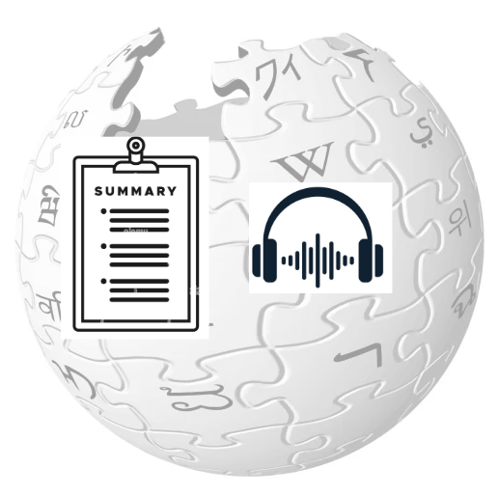
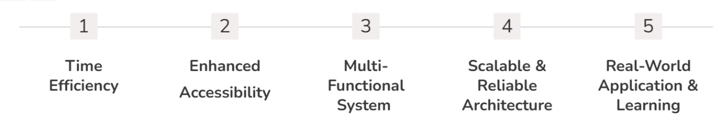
Project Goals
This project aims to enhance the accessibility and efficiency of consuming information from Wikipedia by summarizing articles and converting them into audio.
Key Accomplishments:

Slide 3

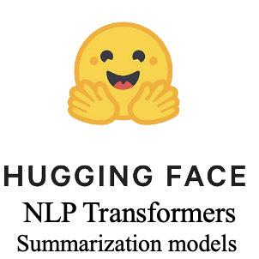








Software and Hardware Components

Slide 4
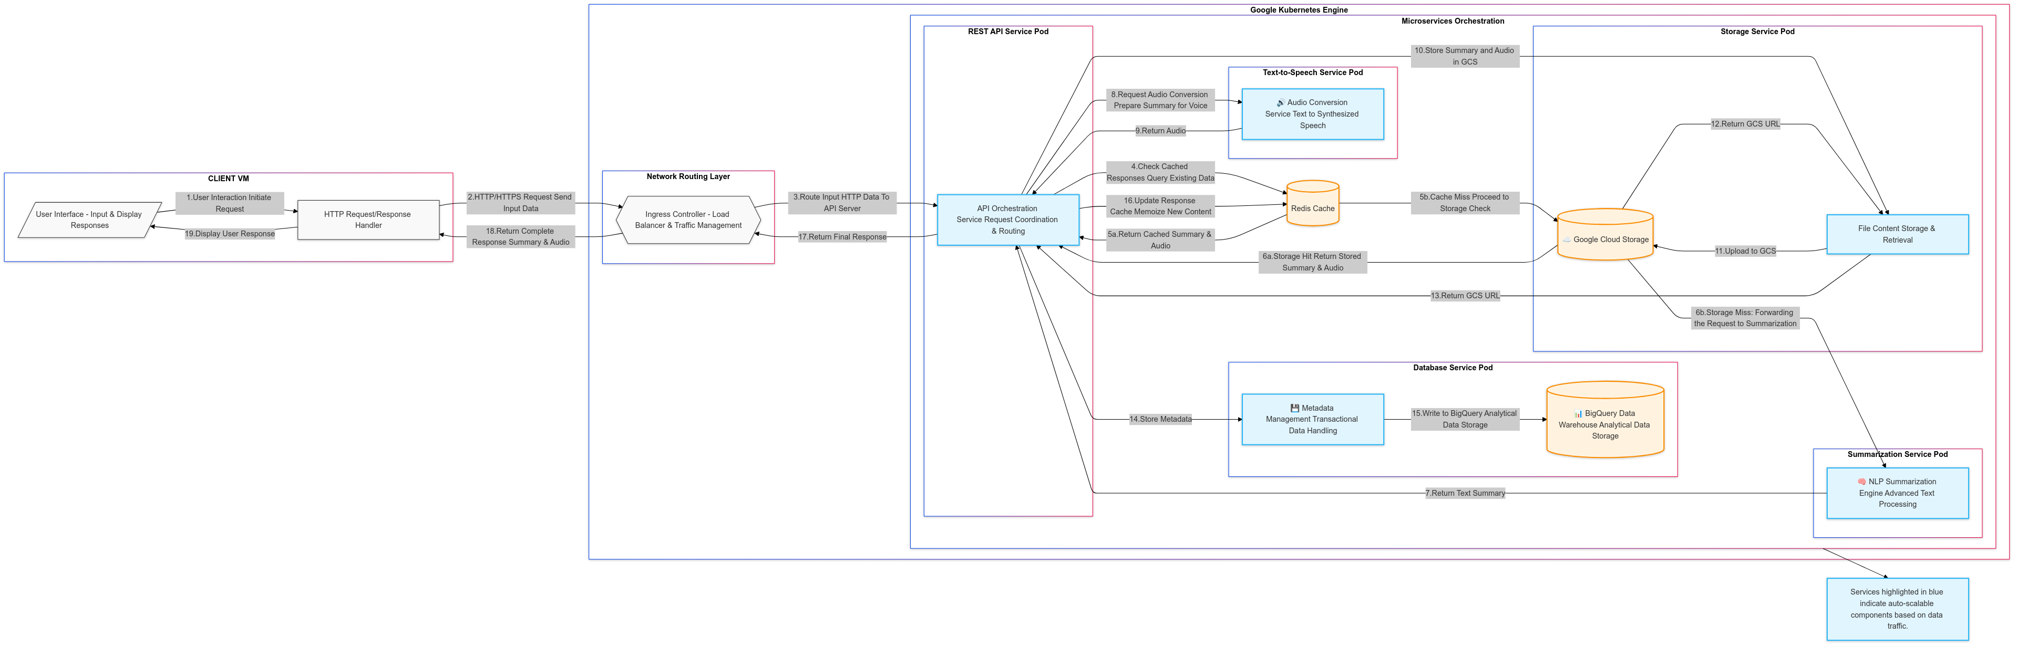
Architecture Diagram & Components Interactions

Slide 5




TESTING
DEBUGGING
Local Testing
Conducted initial service testing locally using Docker to ensure functional integrity before cloud deployment.
Logging and Monitoring
Implemented systematic logging across services to monitor data flow and identify issues in real-time.
Cloud Migration & Testing
Gradually migrated services to Google Kubernetes Engine (GKE), adjusting service logic for cloud-specific configurations and testing with kubectl and curl for endpoint functionality.
Error Handling
Integrated robust error handling with try-catch blocks across all services to manage exceptions effectively.
Integration Testing
Performed comprehensive integration testing on GKE to validate the interaction between services, using pod logs for detailed insights.

Slide 6
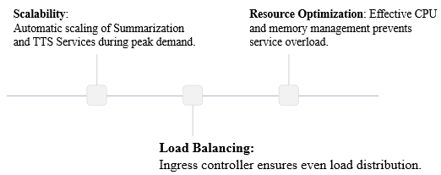
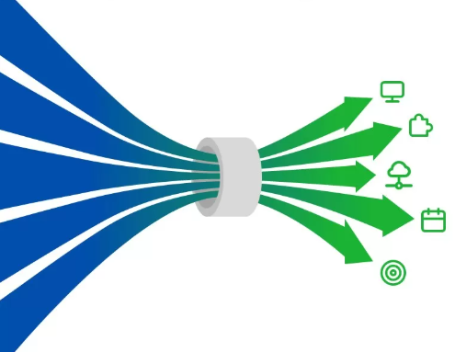
Capabilities
Summarization Service: Delays from complex NLP; solved by autoscaling.
TTS Service: Limited processing power under high load; mitigated by autoscaling and audio caching.
Database Service: Slow writes to Big Query at peak times; addressed with batch processing and schema optimization.
Network Latency: Delays from distributed service setup; improved with network optimization and potential CDN deployment.
Bottlenecks

Slide 7
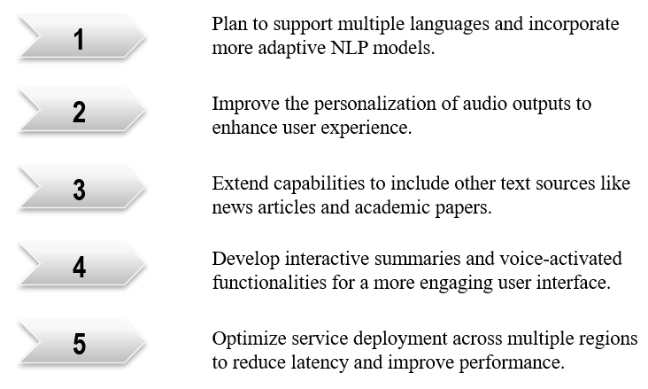

Future Work

Slide 8
Project Demonstration………….

